Slide 1

Data Analysis Project Proposal Drug repurposing – gastric cancer Summer term 2023 17.05.2023 Project 05 - Group 01 Supervisor: Prof. Dr. Carl Herrmann Tutor: Ana Luisa Costa Presenting: Deniz Korkmazel, Evgeniya Abadzhieva, Hanna Friess, María Paula Fuentes

Slide 2
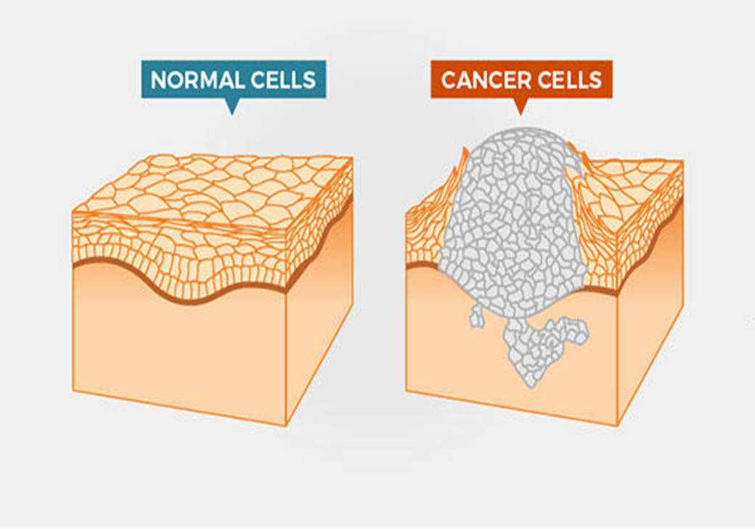
Cancer
Cells grow and reproduce uncontrollably
200 different types
Destroy the surrounding healthy tissue
Metastasis
Image 1: Cancer cells (National Cancer Institute)

Slide 3
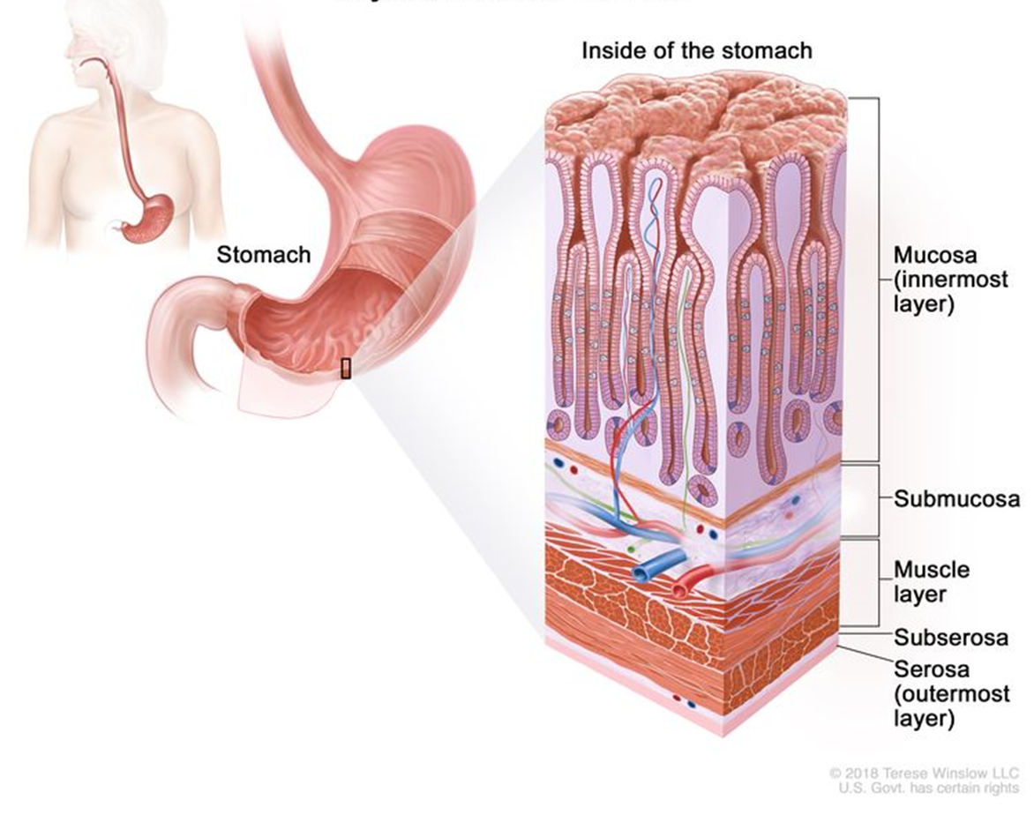
Gastric Cancer
5th highest incidence rate (5.7%)
3rd leading cause of cancer deaths
Image 2: Layers of the stomach wall (National Cancer Institute)

Slide 4



Drug repurposing
SHORTER TIME FRAME
LOWER COSTS
LOWER RISK OF FAILURE

Slide 5
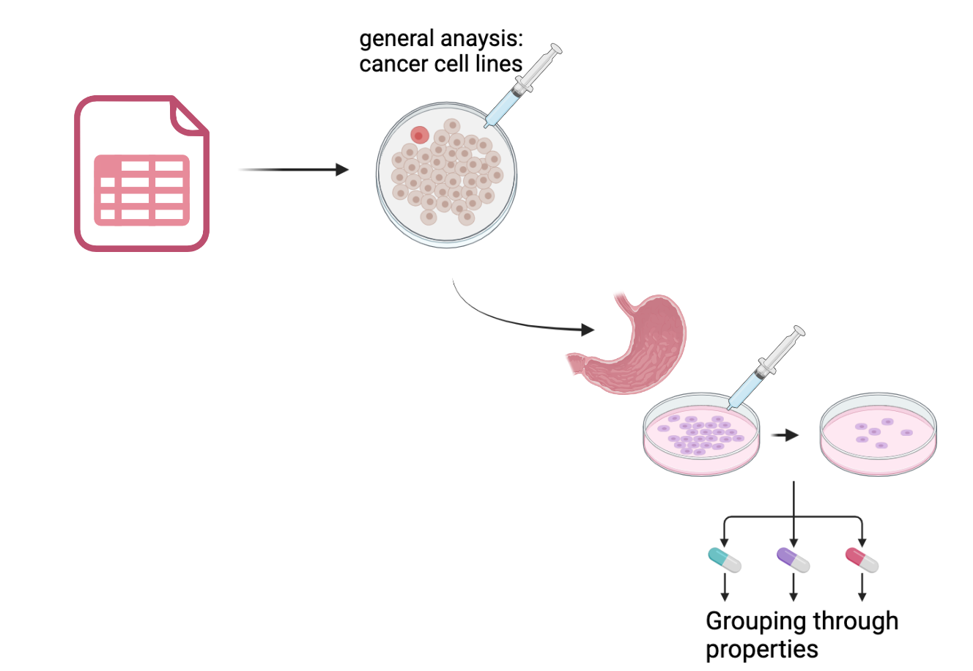
Main objective
Identifying potential cancer treatments with a particular focus on gastric cancer and grouping them into subgroups based on their properties
Image 3: Created with Biorender

Slide 6
Our datasets
Prism
Prism.treat
Prism.cl
Prism.exp
Prism.cnv
Prism.snv
Prism. Achilles

Slide 7
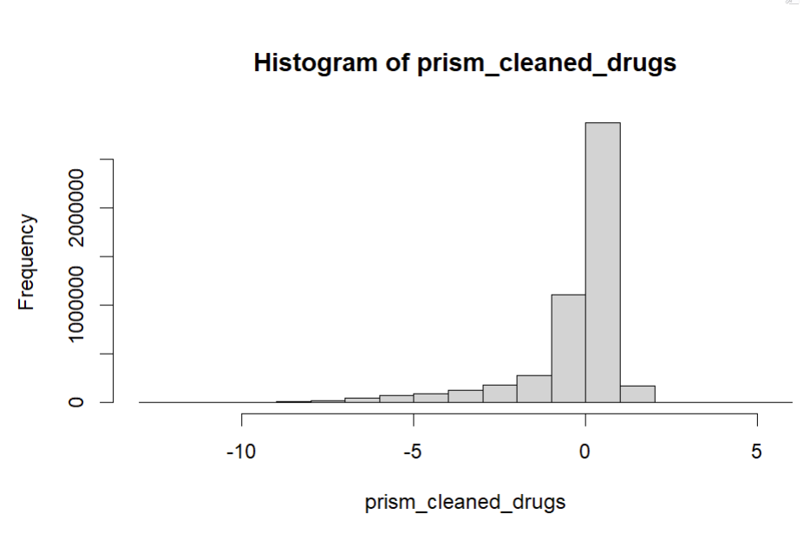
General observation:
Effect of treatments in cancer cell lines
Image 4: Histogram of the prism data

Slide 8
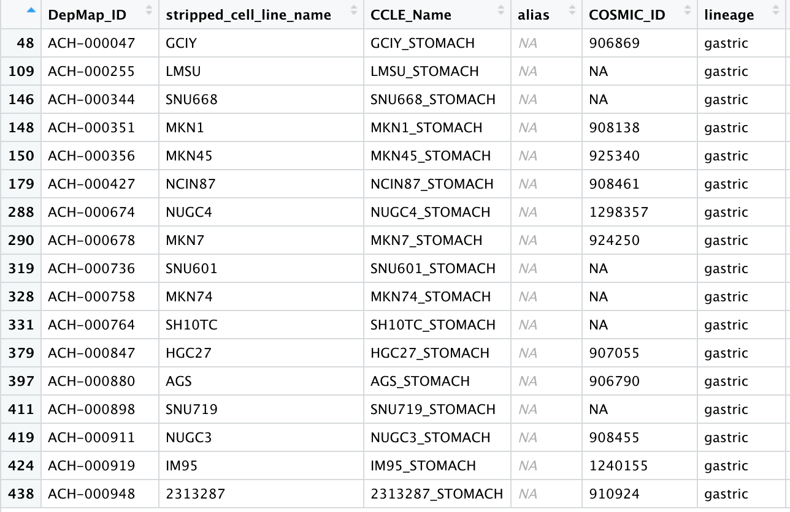
Prism.cl
Information about the cell line's characteristics
→ Relationship between gastric cell line characteristics and treatment response
Image 5: gastric.cancer.celllines

Slide 9
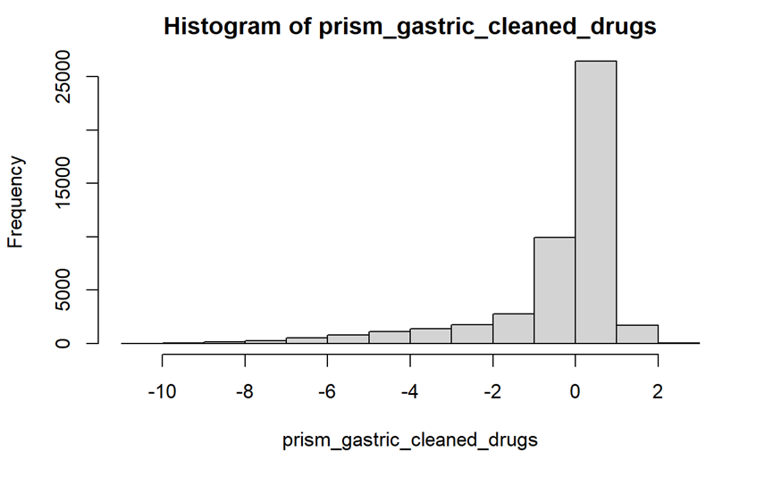
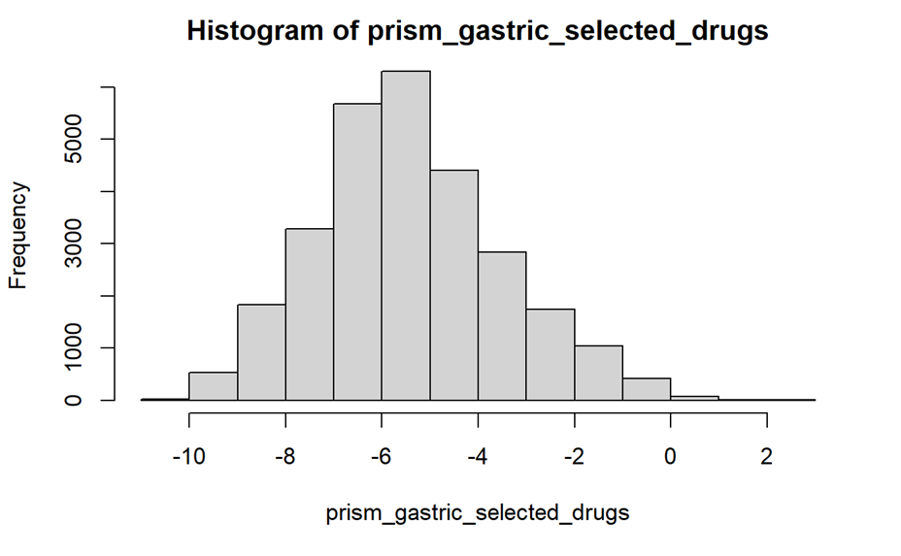
Prism
Image 6: Histogram of prism_gastric_cleaned_drugs
Information about the effect of the treatment on cell growth of cancer cell lines
Image 7: Histogram of prism_gastric_selected _drugs
Notes:
filter the gastric cancer cell lines
-6.5

Slide 10
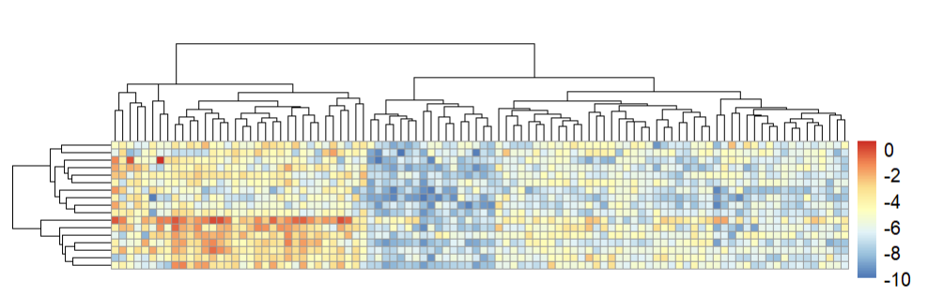
Prism
Heatmap: can display the strength of the drug response to gastric cancer cell lines
Purpose: to identify certain drugs that elicit a strong response
Columns: Effect of the treatment
Rows:cell lines
Image 8 : Heatmap of selected drugs with the gastric cell lines
Notes:
filter the gastric cancer cell lines
-6.5

Slide 11
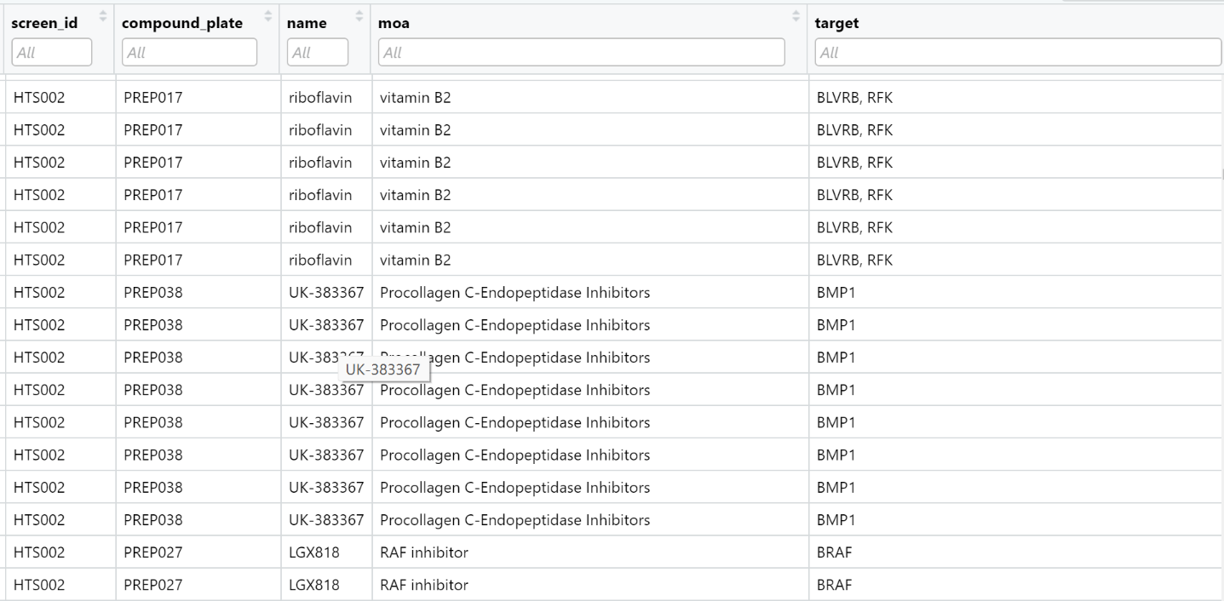
Prism.treat
Image 9: Prism.treat dataframe
Information about the treatment's characteristics
→ Explore relationships between treatment response and treatment properties
For example: pathways, target molecules

Slide 12
Prism.treat
Prism.cl
→Information providers

Slide 13
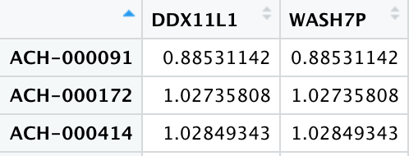
Prism.cnv
Prism.snv
Gene copy (CN) values per gene
Normal: CN = 2
Amplification: CN < 2
Deletion: CN > 2
→ Identify genes with frequent copy number alterations (amplifications or deletions) in gastric cancer cell lines
Mutations observed in a sample
Example: Start/End position, classification, cell line, functional effect
→ Identify frequently mutated genes in gastric cancer cell lines
Notes:
PRISM.cnv and PRISM.snv datasets are information providers that offer additional layers of complexity to the analysis
For further research as the primary
For instance, copy number variations (CNVs) and single nucleotide variants (SNVs) can influence how a cell responds to a particular treatment. Understanding these genomic alterations can help explain why some treatments work for certain cell lines and not for others.
For example, a specific mutation may correlate with a positive response to a certain drug, suggesting that the drug could be repurposed for patients with that mutation.

Slide 14
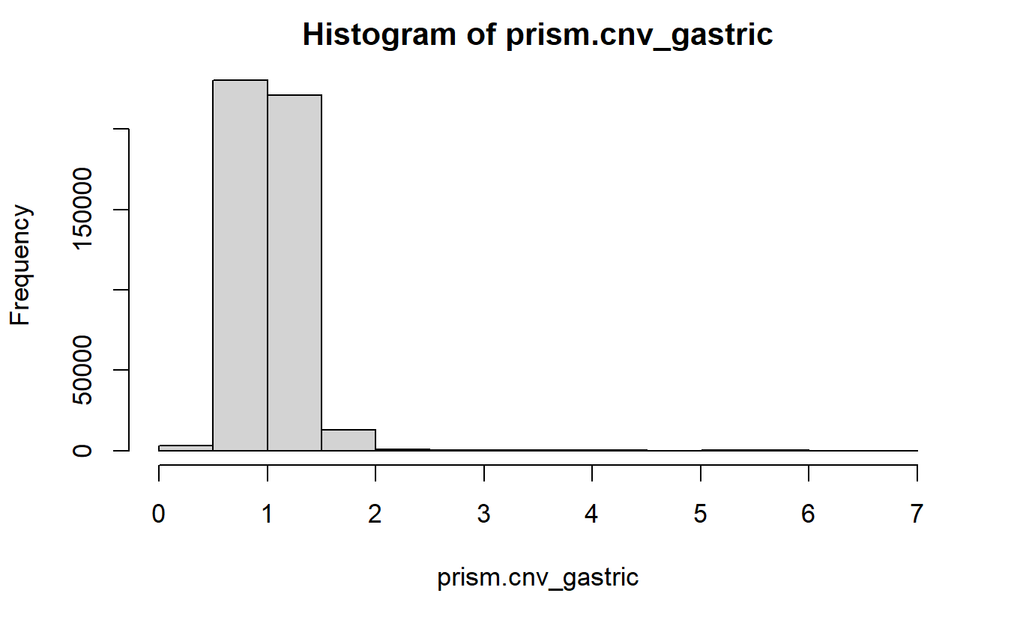
Image 10:

Slide 15
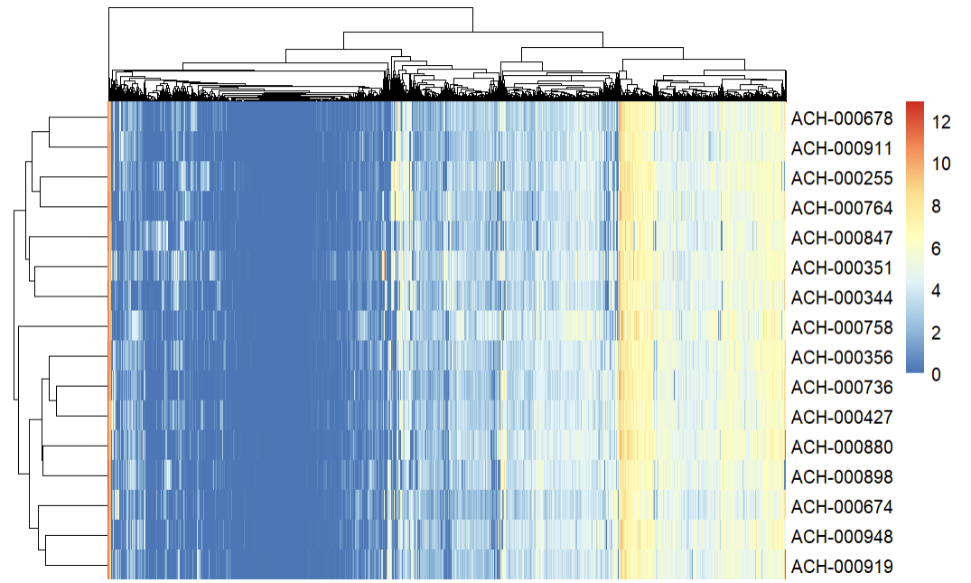
Prism.exp
Columns: Genes
Level of gene expression in cancer cell lines
Heatmap: To visualize the patterns of gene expression across gastric cell lines
Purpose: identify potential targets for the drugs
Image 11

Slide 16
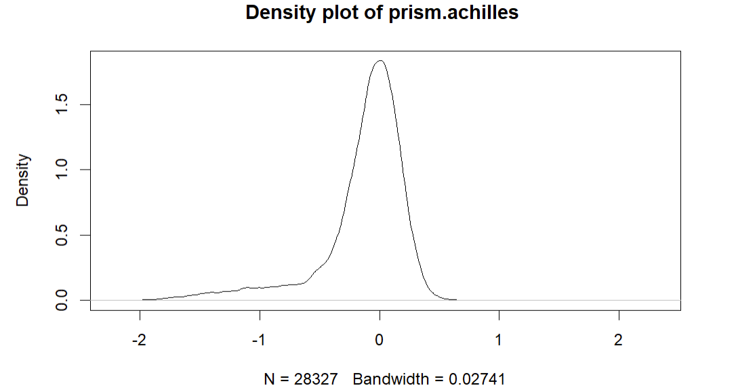
Prism.achilles
Reflect the importance of a specific gene for the cell survival
Density plot: Visualization of the distribution of the proliferation scores dependent on gene knockdown
Purpose: identify genes that are essential or non-essential for the cell survival
Image 12

Slide 17
Our Strategy
Filter gastric cancer cell lines
Analyse treatment response
Treatment property analysis
Group treatments based on properties
Model of prediction
Validate findings
Identify effective treatments for subtypes
Main objective:
Identifying potential cancer treatments with a particular focus on gastric cancer and grouping them into subgroups based on their properties
Notes:
main objective: identifying potential gastric cancer treatments and grouping them into subgroups based on various properties:
Filter gastric cancer cell lines: From the PRISM.cl dataset, filter the cell lines that are specific to gastric cancer based on lineage.
Analyisis treatment response: Extract treatment response data for the gastric cancer cell lines from the PRISM dataset. Perform clustering analysis or other dimensionality reduction to group treatments with similar response profiles across these gastric cancer cell lines.
Investigate treatment properties: Merge the PRISM.treat dataset with the treatment response data for gastric cancer cell lines. This will provide information on the mechanism of action, target molecule, and other properties of the treatments.
Group treatments based on properties: Perform clustering or other dimensionality reduction techniques to group treatments with similar properties, such as target molecule, mechanism of action, or pathway.
Identifying genetic markers that are correlated with a effectiv drug response in cancer cell lines
Find effective treatment for gastric cancer based on gene expression
Investigate gastric cancer subtypes: Cluster gastric cancer cell lines based on their gene expression (PRISM.exp), copy number variation (PRISM.cnv), or mutation (PRISM.snv) profiles to identify distinct gastric cancer subtypes.
Identify effective treatments for subtypes: Analyze the relationship between treatment response and gastric cancer subtype cell lines. To identify which treatments are more effective for specific gastric cancer subtypes.
Validate findings: Use external databases or literature to validate your findings on the effectiveness of the identified treatments for gastric cancer.

Slide 18

Timeline
Week 0
Week 1
Week 2-3
Filter gastric cancer cell lines
Project Proposal
Analyse treatment response
Treatment property analysis
Week 7
Week 5-6
Week 5
Week 4
Model of prediction
Validate findings
Identify effective treatments for subtypes
Group treatments based on properties
Week 8
Week 9: 19.07.23
Report and Presentation
Final Presentation
Notes:
main objective: identifying potential gastric cancer treatments and grouping them into subgroups based on various properties:
Filter gastric cancer cell lines: From the PRISM.cl dataset, filter the cell lines that are specific to gastric cancer based on lineage.
Analyisis treatment response: Extract treatment response data for the gastric cancer cell lines from the PRISM dataset. Perform clustering analysis or other dimensionality reduction to group treatments with similar response profiles across these gastric cancer cell lines.
Investigate treatment properties: Merge the PRISM.treat dataset with the treatment response data for gastric cancer cell lines. This will provide information on the mechanism of action, target molecule, and other properties of the treatments.
Group treatments based on properties: Perform clustering or other dimensionality reduction techniques to group treatments with similar properties, such as target molecule, mechanism of action, or pathway.
Identifying genetic markers that are correlated with a effectiv drug response in cancer cell lines
Find effective treatment for gastric cancer based on gene expression
Investigate gastric cancer subtypes: Cluster gastric cancer cell lines based on their gene expression (PRISM.exp), copy number variation (PRISM.cnv), or mutation (PRISM.snv) profiles to identify distinct gastric cancer subtypes.
Identify effective treatments for subtypes: Analyze the relationship between treatment response and gastric cancer subtype cell lines. To identify which treatments are more effective for specific gastric cancer subtypes.
Validate findings: Use external databases or literature to validate your findings on the effectiveness of the identified treatments for gastric cancer.

Slide 19
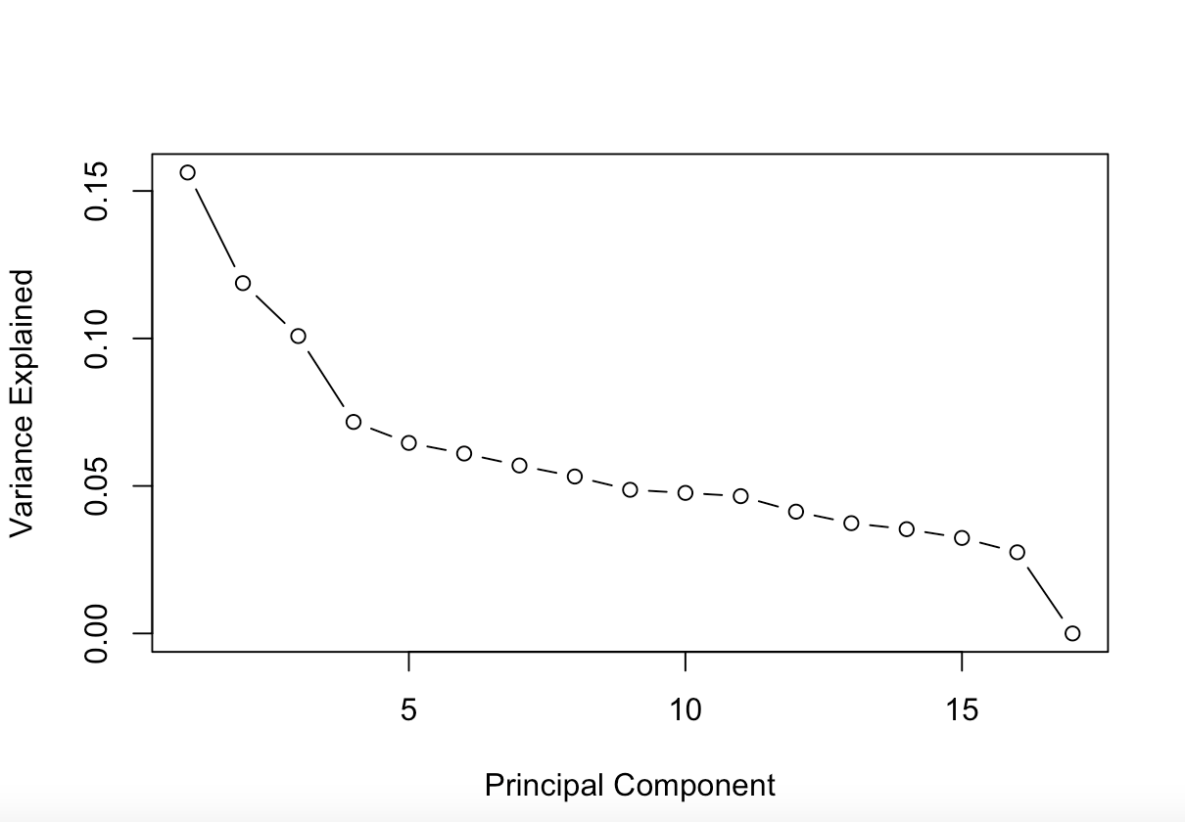
PCA
Dimension reduction of data
Referring to our project:
Drug response of cancer cell lines (prism)
Gene expression (prism.exp)
Importance of the genes for the cell survival (prism.achilles)
Purpose:
→data reduction
→identify important factors
→ identify drugs with similarities
Image 13
Notes:
Group treatments based on properties

Slide 20
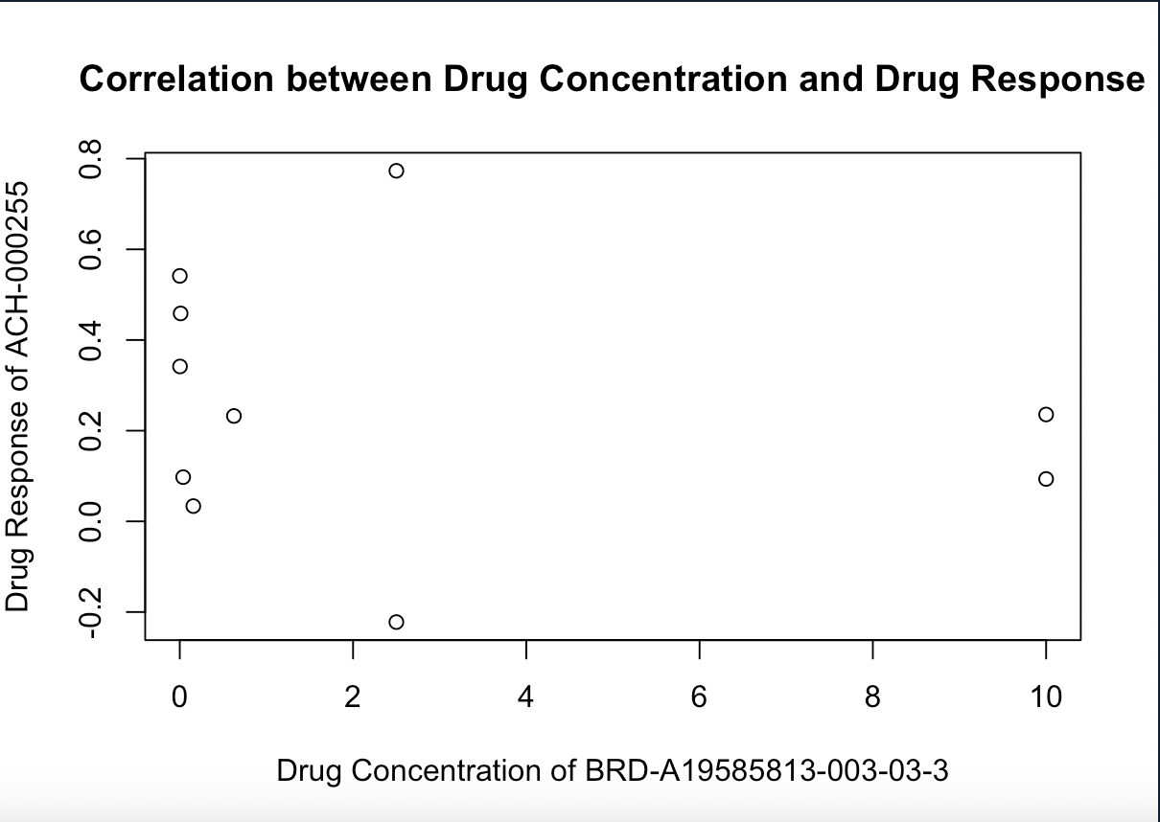

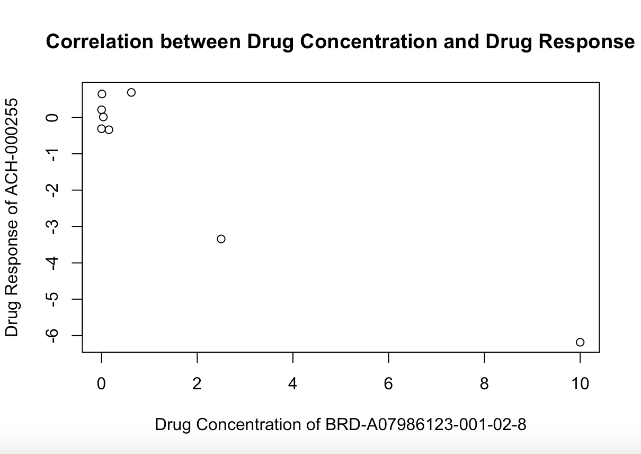

Pearson correlation
Finding linear relationship between two continuous variables
Purpose:
To identify:
genes associated with genomic instability.
potential targets for further research.
important drug factors that influence the drug response.
esential genes that play a role in specific processes or outcomes
Image 14
Image 15
Notes:
Group treatments based on properties

Slide 21
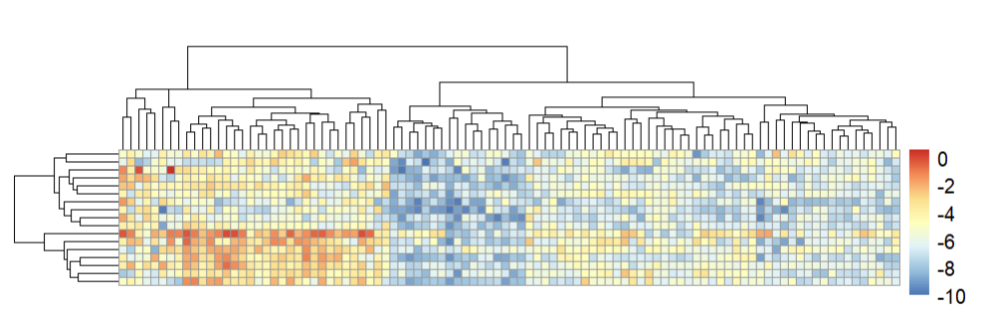
Clustering
Dimension reduction of data
Purpose:
Pattern recognition of data
Potential relationships
Reduction of dimension
Gaining a high-level overview of the data's organization
SIMILARITIES
Columns: Effect of the treatment
Rows:cell lines
Image 16 : Heatmap of selected drugs with the gastric cell lines
Notes:
Group treatments based on properties

Slide 22
Hypothesis Testing
T- Test
Purpose:
To decide whether the data at hand sufficiently support a particular hypothesis
Referring to our project:
→ identifying significant differences between groups,
→ Revealing how certain characteristics can impact treatment response
Notes:
Group treatments based on properties

Slide 23
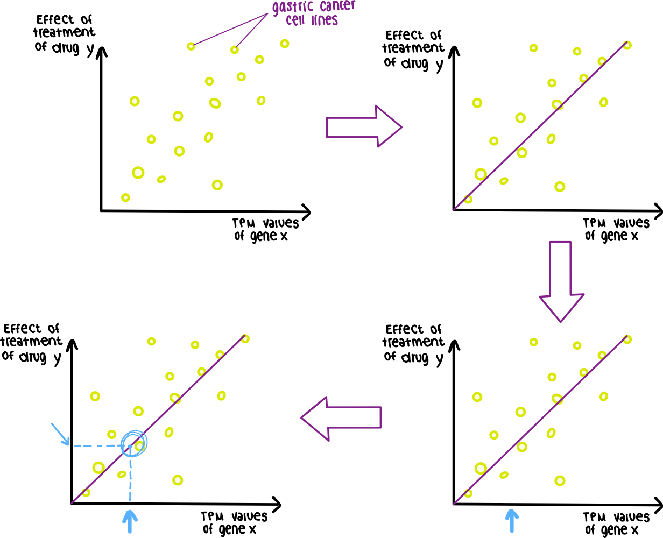
Linear Regression
Predictive statistical method
Modeling the relationship between
→ dependent variable and one or more independent variables
Referring to our project:
→ modeling the relationship between treatment response and properties of the cell lines
Goal:
To predict the response to a specific treatment in gastric cancer cell lines
For example:
Image 17
Notes:
Group treatments based on properties

Slide 24

Thank you for listening !

Slide 25
Back up

Slide 26
Pearson correlation (+scatter plot to visualize the correlation):
linear relationship between two continuous variables:
• to explore the relationship between the expression levels of a particular gene and its copy number variation in different cancer cell line(prism.exp and prism.cnv)
• Aim: to determine whether there is a significant correlation between the two variables, and potentially identify genes that are associated with genomic instability or oncogenesis, and identify them as a target
• to examine the relation between drug concentration/disease area/target and drug response(prism+prism.treat)
• Correlation between genetic alterations and drug sensitivity(prism.snv,prism.cnv + prism)
• Correlation between gene knockdown and drug response: the drug is effective because this particular gene is suppressed?
To sum up:
- To identify genes which are associated with genomic instability
- To identify potential targets
- To identify drug factors with are important for the drug response
To identify essential genes
I am leaving this here, this is not the final look

Slide 27
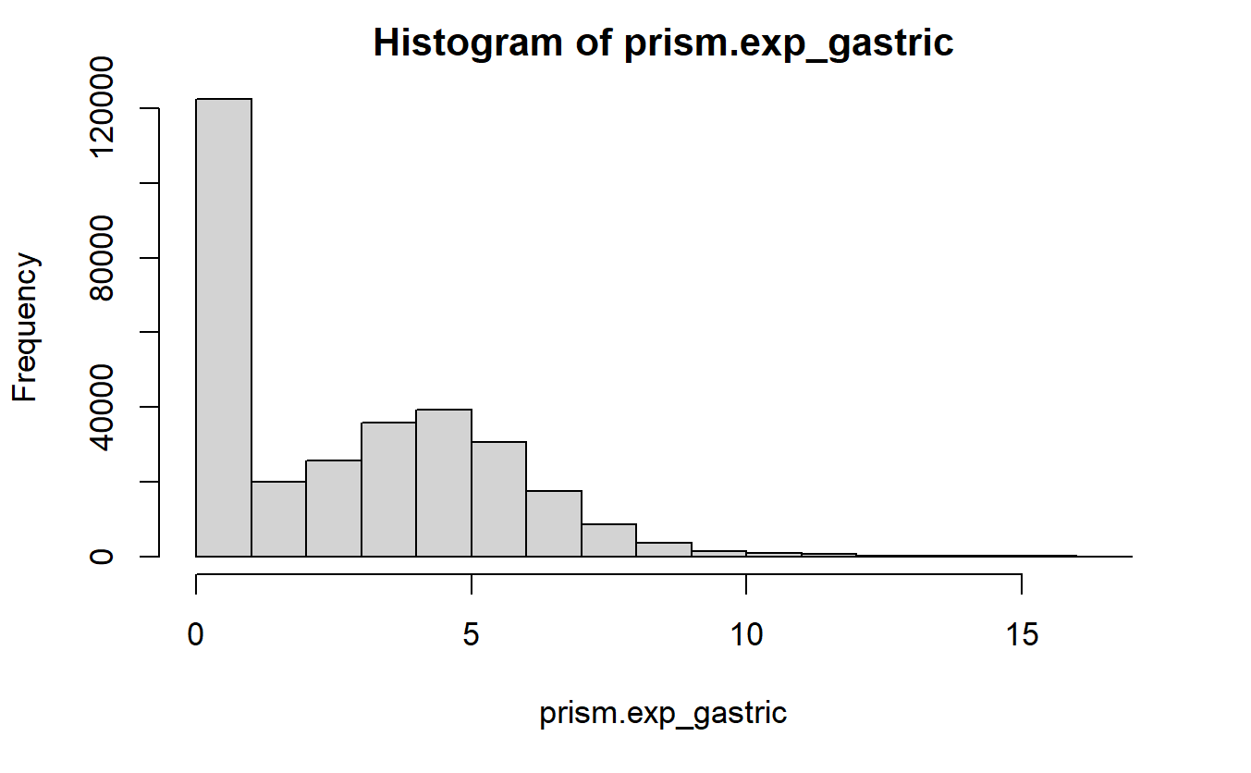
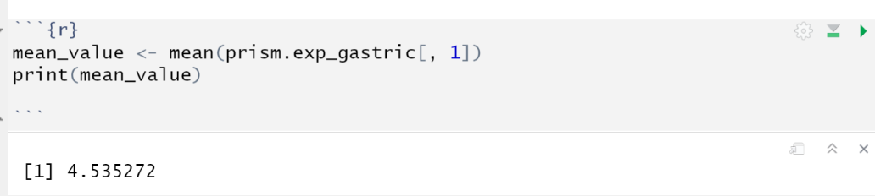
Prism.exp
•Level of gene expression in cancer cell lines
→TSPAN6 gene expression
Image: mean value of TSPAN6 gene expression

Slide 28
Linear regression is a predictive statistical method for modeling the relationship between a dependent variable (also called the outcome or response variable) and one or more independent variables (also called predictors or explanatory variables).
In the context of our project, linear regression could be used to model the relationship between treatment response (the dependent variable) and various properties of the treatments or cell lines (the independent variables)
Level of gene expression
Presence of certain mutations
Copy number of variations
To predict the response to a specific treatment in gastric cancer cell lines

Slide 29
What did we do so far?
🡪 gastric.cancer.celllines
Prism.cl

Slide 30
Prism.treat
Prism.cl
Date frame
Information about the cell line's characteristics
481 cell lines (rows) & 29 information aspects (columns)
Example: linage (subtype), disease (subtype)
🡪 Stratification of cell lines:
🡪 Relationship between gastric cell line characteristics and treatment response
Data frame
Information about the treatment's characteristics
11,168 treatments (rows) & 11 aspects treatments (columns)
Example: Dose, Name, moA, Target,
🡪 Explore relationships between treatment properties and treatment response

Slide 31
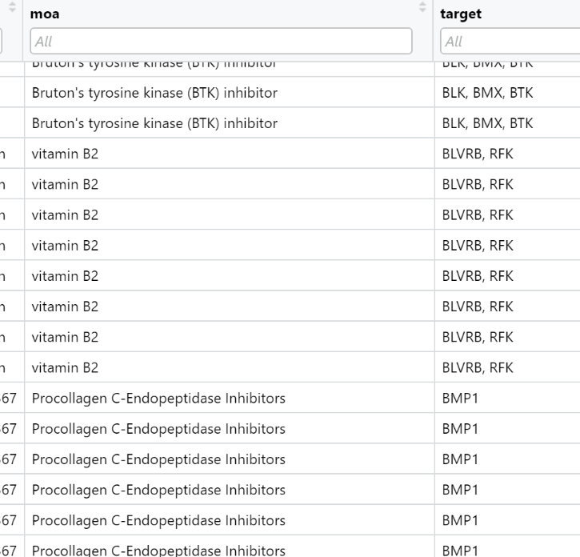
Prism.treat
Prism.cl
Information about the treatment's characteristics
🡪 Explore relationships between treatment responseand treatment responseproperties
→pathways, target molecules
Information about the cell line's characteristics
🡪 Stratification of cell lines
🡪 Relationship between gastric cell line characteristics and treatment response

Slide 32
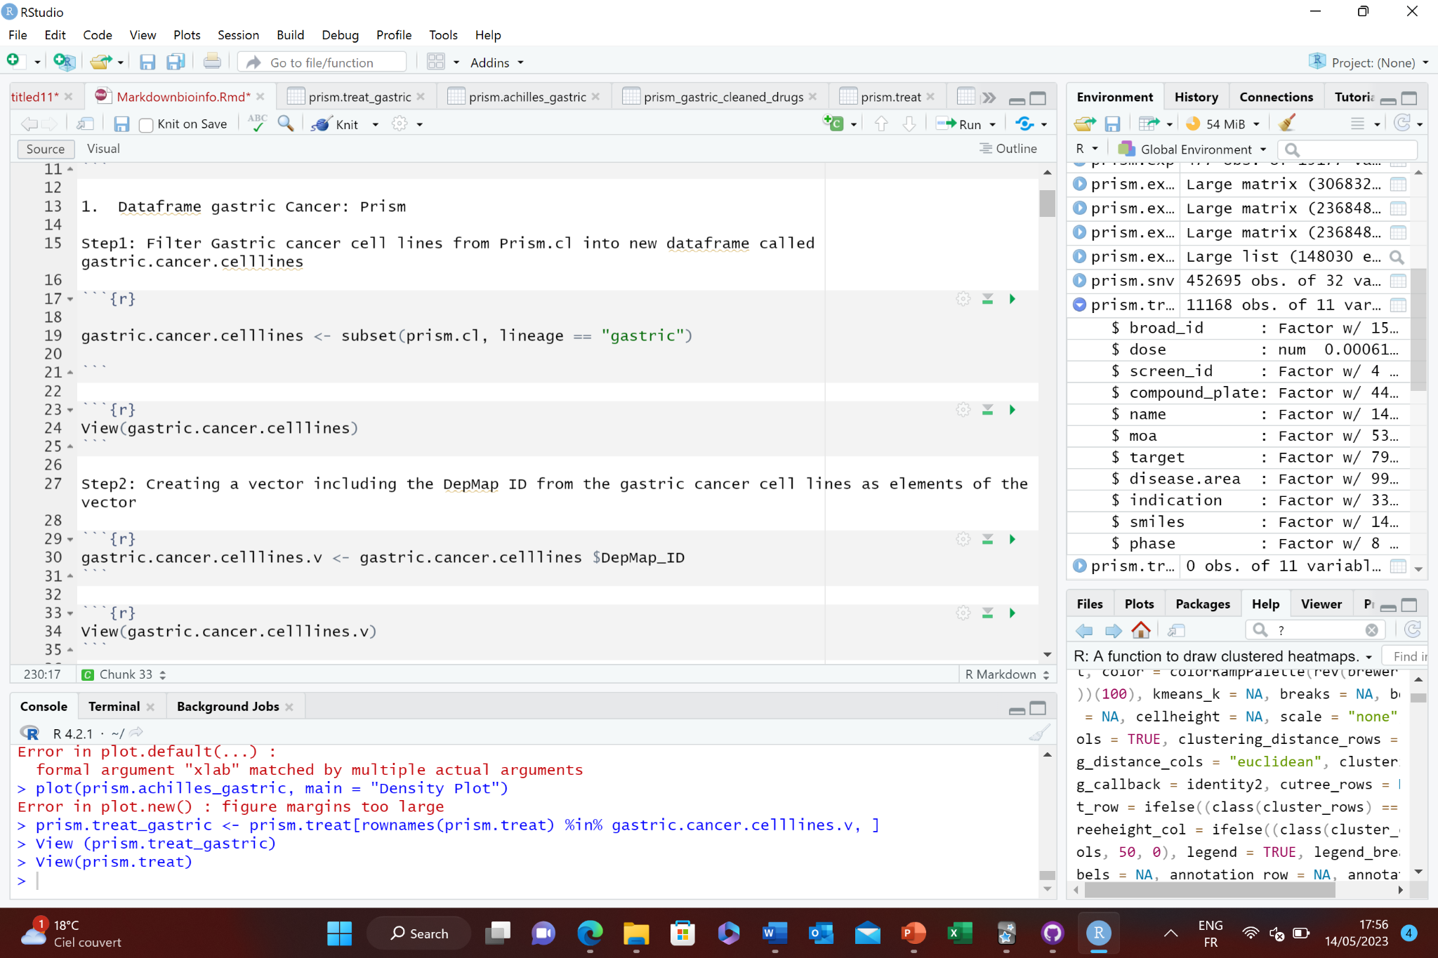
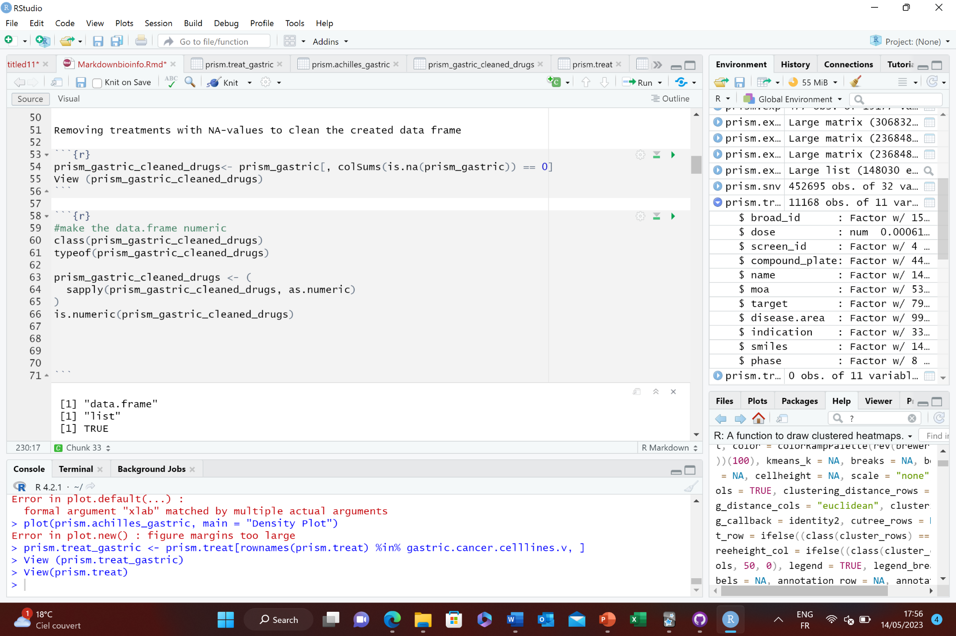
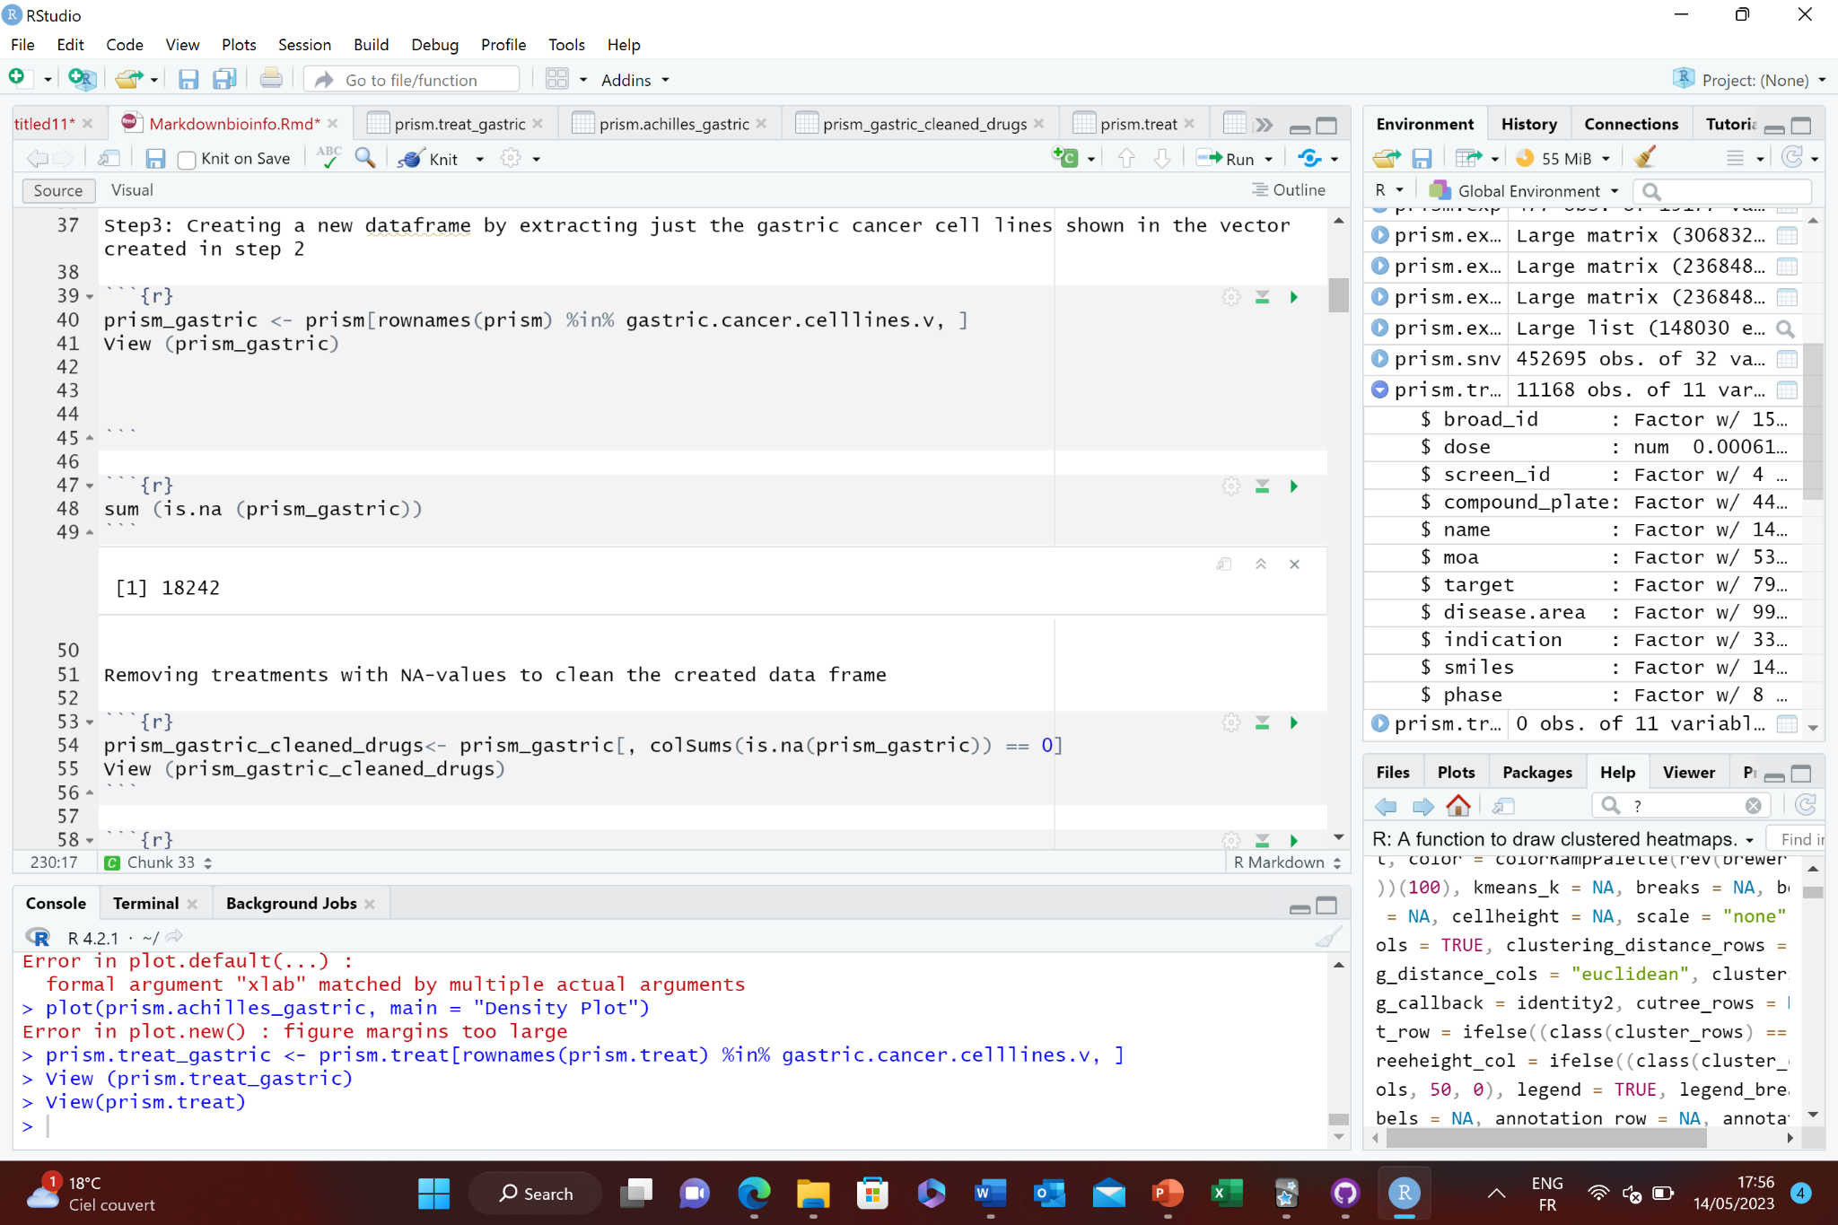
Code of data cleanup

Slide 33
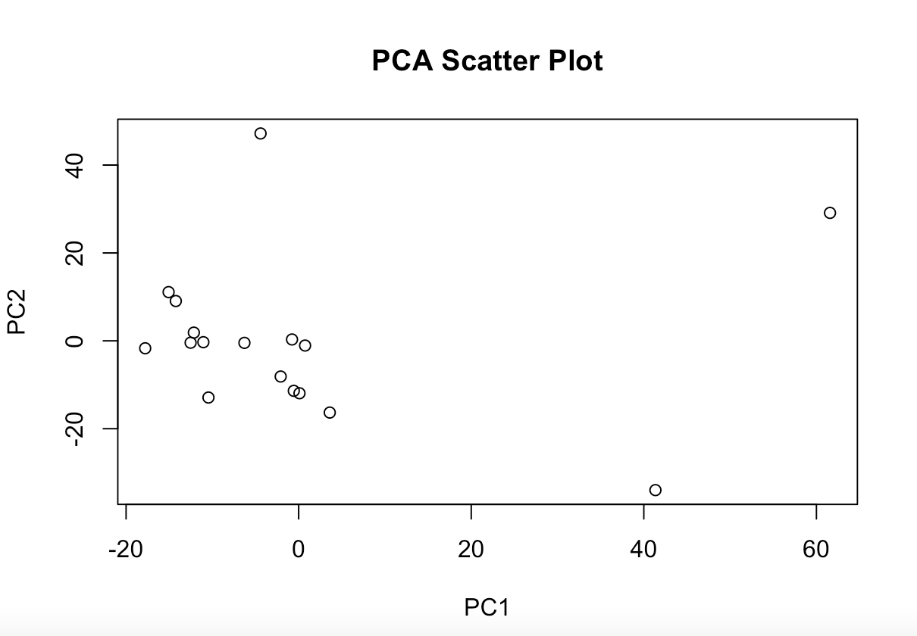

Slide 34
Group treatments based on properties
How did you decide on the specific properties to focus on when grouping treatments in step 4?
The properties we chose for grouping treatments are based on the available data in the PRISM.treat dataset, which includes properties like the mechanism of action, target molecules, and other relevant factors. These properties have been chosen as they have a direct influence on treatment response and effectiveness. This we know through general knowledge, but also in the literature we read, they tried to pave the pathways between the drug and thir target protein and it counts as grouping by properties. Here the drug- target protein pair.
We plan to use standard clustering techniques such as K-means or hierarchical clustering
Each treatment can then be represented as a point in a three-dimensional space, with the coordinates of the point given by the values of these three properties.
The result is a grouping of treatments into clusters, where each cluster represents a group of treatments that are similar to each other (in the sense that they are near each other in the feature space) and dissimilar from the treatments in other clusters.

Slide 35
Hypothesis Testing
T- Test
Can you further explain how the t-test contributes to your main objective of identifying potential cancer treatments and grouping them based on various properties?
The t-test is crucial to our project as it helps in quantifying whether the difference in treatment responses between groups of cell lines is significant or just due to random chance. It serves as a tool for identifying key variables (like specific mutations) that might influence treatment effectiveness, thus enabling us to group treatments based on these characteristics
Could you elaborate on why you chose to focus on mutations in amplified genes? What is the significance of these specific mutations in the context of gastric cancer?
We focus on mutations in amplified genes because these mutations often lead to overexpression of the gene product, which could drive cancer progression. Identifying how these mutations influence treatment response can provide important insights into the mechanisms of gastric cancer and potential therapeutic targets.
How do you plan to handle cases where the t-test results are not clear cut or where the assumptions of the t-test are violated?
If the assumptions of the t-test are violated, we might consider using non-parametric tests like the Mann-Whitney U test

Slide 36
Hypothesis Testing
T- Test
Parametric Tests:
These tests assume that the data follows a certain distribution, usually a normal distribution.
They also assume that the samples are drawn from a population with specific parameters like mean and standard deviation.
They are more powerful and can provçide trustworthy results when their assumptions are met.
Examples: t-tests, Analysis of Variance (ANOVA), Linear Regression.
Non-Parametric Tests:
These tests do not assume that the data follows any specific distribution.
They are more robust against violations of assumptions and can be used when the data is skewed, has unequal variances, or is ordinal or ranked.
However, they may require larger sample sizes to achieve the same power as parametric tests.
Examples: Mann-Whitney U test, Wilcoxon Signed-Rank test, Kruskal-Wallis
How to know if data is normal: Visual Inspection: Plotting histograms or a Q-Q (quantile-quantile) plot can provide a good visual indication of whether the data is normally distributed

Slide 37
Hypothesis Testing
T- Test
Example: Prism. Snv
Here for example: To identify if mutations in amplified genes influence treatment response differently than other mutations (in not amplifies genes) in gastric cancer cell lines.
Hypothesis:
Two-sample T-test
Null Hypothesis: There is no difference in treatment response between gastric cancer cell lines with mutations in amplified genes and those with other mutations
Alternative Hypothesis: There is a difference in treatment response between these two groups in gastric cancer cell lines.
Perform t-test: calculate a t-value that measures the difference in means between the two groups relative to the variability within each group.
Interpret Results: The result of a t-test is a p-value. If this p-value is less than then chosen significance level (usually 0.05) -> reject the null hypothesis that there's no difference in treatment response between the two groups.
Instead, when there is a statistically significant difference in treatment response between gastric cancer cell lines with mutations in amplified genes and those with other mutations. This might suggest that the presence of mutations in amplified genes influences the way these cell lines respond to treatments.
The p-value is a measure of statistical significance. It represents the likelihood of data, given that the null hypothesis is true.
If the p-value is small (commonly under 0.05), it means that the likelihood of observing, assuming the null hypothesis is true, is very low. In this case, you would reject the null hypothesis and conclude that there is a statistically significant effect or difference.

